Slide 1

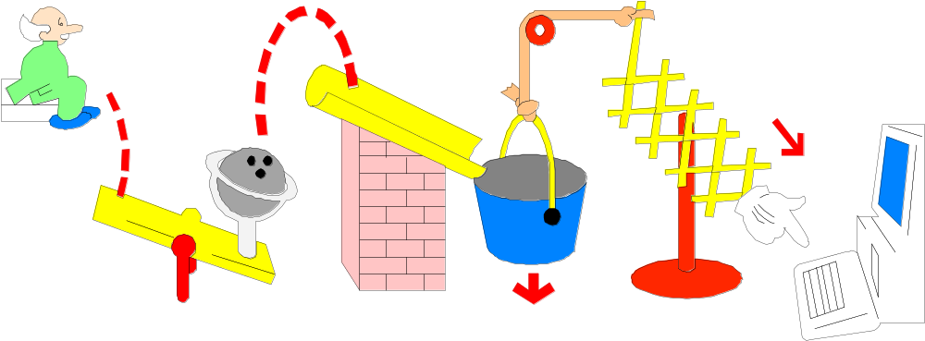
5. Substantive Analytical Procedures
A major purpose is to gain an understanding
of the client’s business and industry.

Slide 2
5. Substantive Analytical Procedures (Cont’d)
Standar yang digunakan:
  PSA No 22 – Prosedur Analitik
  ISA 520 – Analytical Procedures
“Analytical procedures” means evaluations of financial information made by a study of plausible relationships among both financial and non-financial data. Analytical procedures also encompass the investigation of identified fluctuations and relationships that are inconsistent with other relevant information or deviate significantly from predicted amounts.

Slide 3
5. Substantive Analytical Procedures (Cont’d)
Analytical procedures use comparisons and
relationships to assess whether account
balances or other data appear reasonable.
Analytical procedures include evaluations of financial information using plausible relationships among financial and non-financial data, internal data, or available external data. In effect, the analytical procedures should provide evidence of whether the company’s results are consistent with its operations.

Slide 4
5. Substantive Analytical Procedures (Cont’d)
Advantages of substantive analytical procedures:
  Knowledge of the Business and Client Service
  Efficiency
  Understatement Tests

Slide 5
5.1 Timing of Substantive Analytical Procedures
Timing of substantive analytical procedures:
  If practicable, auditor should consider performing the substantive analytical procedures at an interim date as well as at the balance sheet date.

Slide 6
5.1 Timing of Substantive Analytical Procedures (Cont’d)
The advantages of performing substantive analytical procedures at an interim date may include:
  Unanticipated problems
  Missing factors
  Addressing misstatements
  Shifting works

Slide 7
5.2 Uses of analytical procedures
Three different uses of analytical procedures:
  Preliminary analytical procedures used in audit planning to identify areas of concern or anomalies and to obtain a general understanding of the content of the financial statements.
  Substantive analytical procedures used to test for material potential errors affecting an account or class of transactions substantively.
  Analytical procedures used as part of the final review of the financial statements

Slide 8
5.2 Uses of analytical procedures (Cont’d)
Purpose
(Required)
Planning Phase
Understand client’s
industry and business
Primary purpose
Assess going concern
Secondary purpose
Indicate possible misstatements
(attention directing)
Primary purpose
Reduce detailed tests
Secondary purpose

Slide 9
5.3 Preliminary analytical procedures
Preliminary analytical procedures are a planning tool and their purpose is to:
  Obtain a general understanding of the content of the financial statements.
  Identify significant operational or accounting changes that have occurred since prior audit.
  Identify unusual changes or the absence of anticipated changes that may indicate specific risks of material misstatement.

Slide 10
5.3 Preliminary Analytical Procedures (Cont’d)
  Enhance our understanding of the client’s business.
  Assist in the determination of planning materiality
  Identify matters that may call into question the client’s ability to continue as a going concern.

Slide 11
5.4 Substantive Analytical Procedures
Substantive analytical procedures involve developing expectations of the amount to be tested using data that is independent of the financial recording of the amount to be tested, but that is expected to be predictive of the amount. Such data may be financial or non financial, internally generated, or externally derived.

Slide 12
5.4 Substantive Analytical Procedures (Cont’d)
Compare client and industry data.
Compare client data with similar prior-period data.
Compare client data with client-determined expected results.
Compare client data with auditor-determined expected results.
Compare client data with expected results, using nonfinancial data.

Slide 13
5.4 Substantive Analytical Procedures (Cont’d)
The “threshold” is the primary criterion for selecting differences for investigation and represents the maximum difference that is acceptable without explanation.
If a difference is less than threshold, it is not indicative of material misstatement and, therefore, need not to be investigated.
Threshold should be sufficiently small to enable auditor to identify misstatements that could be material either individually or when aggregated with misstatements in other disaggregated portions or in other accounts.

Slide 14
5.4 Substantive Analytical Procedures (Cont’d)
Auditor should consider all of the following factors in combination to determine an appropriate threshold:
  Materiality
    Lower Materiality = Lower Threshold
  Desired level of assurance to be achieved from procedures
    Higher level of assurance to obtain from substantive analytical procedures = lower threshold

Slide 15
5.4 Substantive Analytical Procedures (Cont’d)
  Level of desegregation of the amount being tested
    When a population is desegregation, a threshold is applied separately to the differences pertaining to each of the desegregation parts.
  The effect of small populations or desegregated amounts
    When a small populations or desegregated amounts is relatively small compared to other accounts but exceeds auditor’s materiality, misstatement might still contribute in the aggregate to a material amount.

Slide 16
5.4 Substantive Analytical Procedures (Cont’d)
  The precision of the expectation
    The effect of the precision of auditor expectation may be summarized as follows:
Relative Precision of Expectation
Relative Threshold
Relative Level of Assurance
Very Precise
Smaller
Higher
Moderately Precise
Larger
Lower

Slide 17
5.4 Substantive Analytical Procedures (Cont’d)
When analytical procedures identify significant fluctuations or relationships that are inconsistent with other relevant information or that deviate from predicted amounts, the auditor should investigate and obtain adequate explanations and appropriate corroborative audit evidence.
Plausible explanations usually relate to unusual transactions or events, or accounting or business changes.

Slide 18
5.5 Common Financial Ratios
Short-term debt-paying ability
Liquidity activity ratios
Ability to meet long-term debt obligations
Profitability ratios

Slide 19
5.5.1 Short-term debt-paying ability
Cash ratio:
(Cash + Marketable securities) ÷ Current liabilities
Quick ratio:
(Cash + Marketable securities
+ Net accounts receivable) ÷ Current liabilities
Current ratio:
Current assets ÷ Current liabilities

Slide 20
5.5.2 Liquidity Activity Ratios
Accounts receivable turnover:
Net sales ÷ Average gross receivables
Days to collect receivables:
365 days ÷ Accounts receivable turnover
Inventory turnover:
Cost of goods sold ÷ Average inventory

Slide 21

5.5.2 Liquidity Activity Ratios (Cont’d)
Days to sell inventory:
365 days ÷ inventory turnover

Slide 22
5.5.3 Profitability Ratios
Gross Profit Margin:
(Gross Profit ÷ Revenue) x 100%
Net Profit Margins:
(Income before taxes ÷ Revenue) x 100%
Return on total assets:
((Income before taxes + Interest expenses) ÷ Total assets) x 100%

Slide 23
5.6 Analytical Procedures for Financial Statements Review
Analytical procedures for financial statements review, has to main objectives:
  To ensure that the financial statements are consistent with auditor’s knowledge of the business, auditor’s understanding of individual balances and relationship, the audit evidence.
  To assess the appropriateness and completeness of the presentation of, and disclosure in, the financial statements.

Slide 24
5.7 Summary of Analytical Procedures
They involve the computation of ratios and other
comparisons of recorded amounts to auditor expectations.
They are used in planning to understand
the client’s business and industry.
They are used throughout the audit to identify
possible misstatements, reduce detailed tests,
and to assess going-concern issues.

Slide 25
5.8 Examples of highly effective substantive analytical procedures
Financial Statement Amount | Relationship and Procedure
Sales | Selling price applied to volume information about shipments.
Amortization expenses | Amortization rate applied to capital asset balances, allowing for effect of additions and disposals
Overhead element of inventory | Relating actual overheads to actual direct labor or production volumes.
Payroll expenses | Pay rates applied to number of employees.
Commission expenses | Commission rate applied to sales.
Payroll accruals | Daily payroll applied to number of days accrued.

